Slide 1
Project 3
Michael Garverick, Peter Simon, Noah Jaramillo

Slide 2
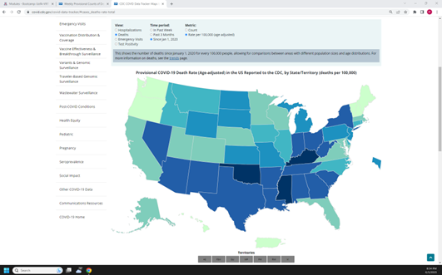
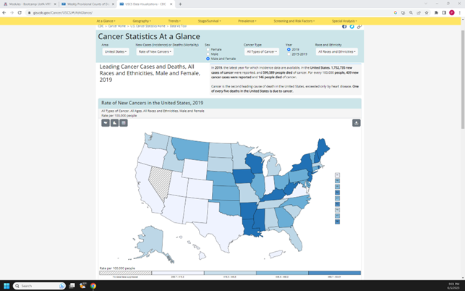
Overview
Wanted to visualize the various causes of death in the US over the last couple of years
Similar to the other visualizations you see on the CDC’s website

Slide 3



Project Process
First started by downloading our dataset as a CSV from the CDC’s website
Did some initial cleaning to rename columns and remove extraneous info we weren’t planning on using
In Python, we converted the CSV file to a SQLite file

Slide 4



Project Process cont.
With our SQLite file, we then created a Python Flask API
With our API, we were then able to incorporate our HTML and JavaScript code

Slide 5
What We Did Well
Quickly and efficiently clean up external data
Figure out the steps to convert the CSV to a SQLite file
Get our Flask app up and running
Basically everything we had covered in the class up until Javascript…

Slide 6
What We Would Do Differently
Struggled the most with the Javascript code
Difficult time getting the data in the correct JSON hierarchy to manipulate the data
Difficult time trying to create visualizations outside of what we had done together in class
Initially planned on creating a choropleth until we realized what we were up against…

Slide 7
Resources
https://data.cdc.gov/NCHS/Weekly-Provisional-Counts-of-Deaths-by-State-and-S/muzy-jte6/explore/query/SELECT%0A%20%20%60data_as_of%60%2C%0A%20%20%60jurisdiction_of_occurrence%60%2C%0A%20%20%60mmwryear%60%2C%0A%20%20%60mmwrweek%60%2C%0A%20%20%60week_ending_date%60%2C%0A%20%20%60all_cause%60%2C%0A%20%20%60natural_cause%60%2C%0A%20%20%60septicemia_a40_a41%60%2C%0A%20%20%60malignant_neoplasms_c00_c97%60%2C%0A%20%20%60diabetes_mellitus_e10_e14%60%2C%0A%20%20%60alzheimer_disease_g30%60%2C%0A%20%20%60influenza_and_pneumonia_j09_j18%60%2C%0A%20%20%60chronic_lower_respiratory%60%2C%0A%20%20%60other_diseases_of_respiratory%60%2C%0A%20%20%60nephritis_nephrotic_syndrome%60%2C%0A%20%20%60symptoms_signs_and_abnormal%60%2C%0A%20%20%60diseases_of_heart_i00_i09%60%2C%0A%20%20%60cerebrovascular_diseases%60%2C%0A%20%20%60covid_19_u071_multiple_cause_of_death%60%2C%0A%20%20%60covid_19_u071_underlying_cause_of_death%60%2C%0A%20%20%60flag_allcause%60%2C%0A%20%20%60flag_natcause%60%2C%0A%20%20%60flag_sept%60%2C%0A%20%20%60flag_neopl%60%2C%0A%20%20%60flag_diab%60%2C%0A%20%20%60flag_alz%60%2C%0A%20%20%60flag_inflpn%60%2C%0A%20%20%60flag_clrd%60%2C%0A%20%20%60flag_otherresp%60%2C%0A%20%20%60flag_nephr%60%2C%0A%20%20%60flag_otherunk%60%2C%0A%20%20%60flag_hd%60%2C%0A%20%20%60flag_stroke%60%2C%0A%20%20%60flag_cov19mcod%60%2C%0A%20%20%60flag_cov19ucod%60/page/filter

